Slide 1
Analyzing Public Health Interventions Using Interrupted Time Series
Chris Austin, MS, MPH
Occupational Health Epidemiologist
Nebraska DHHS

Slide 2
Introduction
Goal of the Presentation:
  The basic principles and components of ITS.
  Methodological considerations and challenges.
  Overview on conducting ITS analysis using Generalized Least Squares (GLS).
Notes:
Public health interventions and policies are vital for improving population health outcomes and preventing disease. Evaluating these interventions is essential to understand their effectiveness and ensure that resources are being used efficiently. Traditional methods like randomized controlled trials (RCTs) are often not feasible for population-level interventions due to ethical, logistical, and practical constraints. Thus, alternative methods like Interrupted Time Series (ITS) analysis provide valuable insights into the impact of these interventions in real-world settings.
Introduction to GLS: Generalized Least Squares (GLS) is an advanced regression technique that extends the capabilities of Ordinary Least Squares (OLS) by accounting for autocorrelation and heteroscedasticity in the data. This makes GLS particularly suitable for time series analysis, where data points are often correlated with their past values.
Why Use GLS in ITS Analysis:
Adjusts for Autocorrelation:Definition: Autocorrelation refers to the correlation of a time series with its own past values.
Challenge: In time series data, autocorrelation can violate the assumption of independence of residuals, leading to biased parameter estimates and underestimated standard errors.
Solution: GLS adjusts for autocorrelation by incorporating the correlation structure directly into the model, ensuring more accurate and reliable estimates.
Benefits of Using GLS in ITS Analysis:
Improved Accuracy: By accounting for autocorrelation and heteroscedasticity, GLS provides more accurate parameter estimates. This accuracy is crucial when evaluating the impact of interventions in ITS analysis.
Robust Statistical Inference: GLS offers robust standard errors, enhancing the reliability of hypothesis tests and confidence intervals. This robustness is particularly important in ITS analysis, where precise estimation of intervention effects is essential for drawing valid conclusions.

Slide 3
Why Use Interrupted Time Series?
ITS analysis is a method for evaluating the impact of interventions, especially when randomized controlled trials (RCTs) are not feasible. It is particularly useful in public health settings where interventions are implemented at a population level.
Advantages of ITS:
Handles Interventions Implemented at Specific Points in Time: ITS is designed to analyze the effect of interventions that start at a clearly defined time point, making it ideal for evaluating sudden policy changes or new programs.
Controls for Underlying Trends: By analyzing data before and after the intervention, ITS can control for pre-existing trends, helping to isolate the effect of the intervention from other ongoing changes.
Suitable for Real-World Settings: ITS can be applied to naturally occurring data, making it suitable for real-world evaluations where controlled experimental conditions are impractical.
Applications:
  Smoking Bans: Evaluating the impact of legislation banning smoking in public places on smoking rates or health outcomes.
  Vaccination Programs: Assessing the effectiveness of new vaccination campaigns on disease incidence rates.
  Health Policies: Analyzing the effect of new health policies, such as changes in healthcare funding or introduction of new screening programs.
Notes:
Public health interventions and policies are vital for improving population health outcomes and preventing disease. Evaluating these interventions is essential to understand their effectiveness and ensure that resources are being used efficiently. Traditional methods like randomized controlled trials (RCTs) are often not feasible for population-level interventions due to ethical, logistical, and practical constraints. Thus, alternative methods like ITS analysis provide valuable insights into the impact of these interventions in real-world settings.
8

Slide 4
Key Components of ITS
Key Components:
  Time Points:
    Definition: Continuous sequence of observations taken at regular intervals.
    Importance: Essential for identifying trends and changes over time.
  Intervention:
    Definition: A specific event or policy implementation that occurs at a known point in time.
    Importance: Acts as the "interruption" in the time series, whose impact is being measured.
  Outcome Measure:
    Definition: The variable of interest that is measured at each time point.
    Importance: Reflects the effect of the intervention. Examples include hospital admissions, disease incidence rates, etc.
  Pre-Intervention Period:
    Definition: The time period before the intervention is implemented.
    Importance: Establishes the baseline trend and allows for comparison with the post-intervention period.
  Post-Intervention Period:
    Definition: The time period after the intervention is implemented.
    Importance: Used to measure changes attributable to the intervention.
  Trend and Level Changes:
    Level Change:
      Definition: A sudden shift in the outcome measure immediately after the intervention.
      Importance: Indicates an immediate effect of the intervention.
    Trend Change:
      Definition: A change in the slope of the outcome measure over time post-intervention.
      Importance: Indicates a gradual effect of the intervention.

Slide 5
Methodological Considerations in ITS Analysis
Autocorrelation:
  Definition: The correlation of a time series with its own past values.
  Challenge: Can inflate the type I error rate, leading to false positives.
  Solution: Use statistical methods such as Generalized Least Squares (GLS) to adjust for autocorrelation.
Seasonality:
  Definition: Regular patterns or cycles in data that repeat over time, such as monthly or yearly trends.
  Challenge: Can obscure the true impact of the intervention if not accounted for.
  Solution: Incorporate seasonal adjustment methods, such as including seasonal dummy variables or using Fourier terms.
Time-Varying Confounders:
  Definition: Variables that change over time and can influence the outcome independently of the intervention.
  Challenge: Can bias the results if not properly controlled.
  Solution: Include time-varying confounders in the regression model to adjust for their effects.
Model Specification:
  Definition: The process of selecting the appropriate variables and functional form for the regression model.
  Challenge: Incorrect model specification can lead to biased or incorrect estimates.
  Solution: Use theory and prior research to guide model specification and conduct sensitivity analyses to test the robustness of results.
Intervention Impact Model:
  Definition: The hypothesized way in which the intervention affects the outcome, such as an immediate level change, a gradual trend change, or both.
  Challenge: Incorrectly specifying the impact model can lead to misinterpretation of the intervention's effect.
  Solution: Pre-specify the impact model based on the nature of the intervention and conduct exploratory analyses if needed.

Slide 6
Autocorrelation
Autocorrelation is important in timeseries analysis and refers to the correlation of a timeseries with its own past values, and it can significantly impact the results of an ITS analysis if not properly addressed.
Definition: Autocorrelation occurs when the residuals (errors) of a model are not independent of each other. This means that the value of the outcome variable at one point in time is correlated with its values at previous points in time.
Analysis: The presence of autocorrelation can lead to:
  Inflated type I error rates, increasing the likelihood of false positives.
  Underestimation of the standard errors, leading to overly optimistic confidence intervals.
Notes:
Autocorrelation refers to the degree of correlation of the same variables between two successive time intervals.
Just as correlation measures the extent of a linear relationship between two variables, autocorrelation measures the linear relationship between lagged values of a time series.
Autocorrelation function:
ACF Plot: Example of an ACF plot with significant spikes indicating autocorrelation.

Slide 7
Example – No control, one intervention
Time = A number, the time in study weeks (1 - 100 months)
Intervention = A binary indication of whether the Intervention has taken place at Time x. In this case a smoking ban.
Post intervention time = A number, the time elapsed since the Intervention
Quantity/Outcome = The thing we want to measure

Slide 8
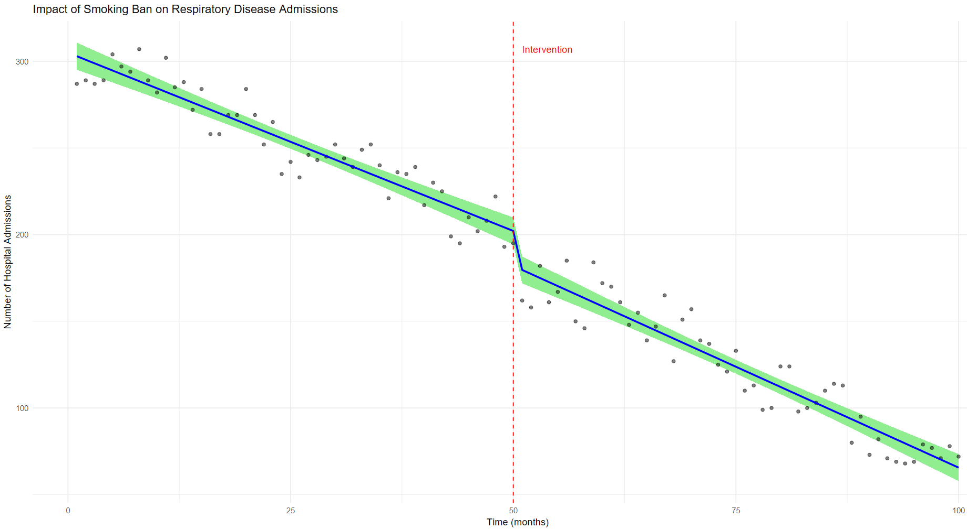
Example – No control, one intervention

Slide 9
Example – No control, one intervention
GLS approach:
ITS model:
  gls(Admissions ~ Time + Intervention + Post_intervention_time, data = df, correlation = corARMA(p = 1, q = 0, form = ~ Time), method=“ML”)

Slide 10
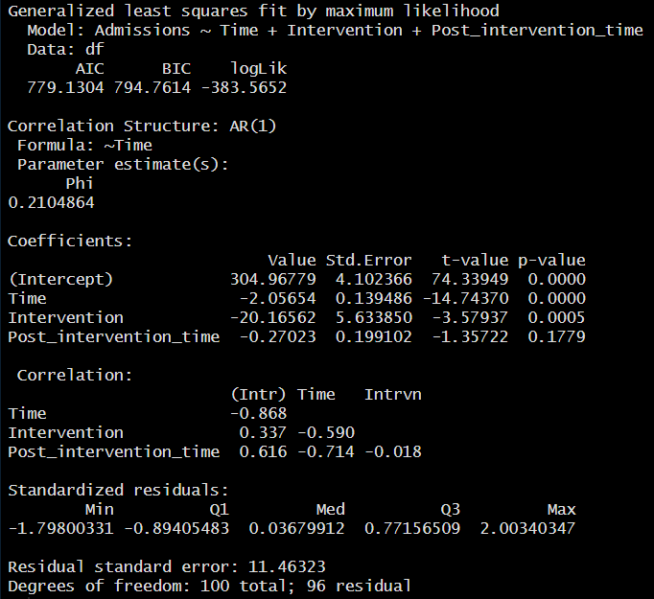
Example – No control, one intervention
This tells us that the model line passes the y axis at 305 admissions.
Prior to the intervention, the average value of admission was falling by 2.1 admissions per month.
At the intervention, there was a step change of -20.2 admissions and after the intervention there was a trend in which the number of admissions fell by additional .27 per month.
The last distinction is important because that means that after the intervention, the monthly decrease in admissions was 2.1 + .27 = 2.37
Notes:
These coefficients have actual meaning and are not there to be ignored.
This tells us that the model line passes the y axis at 305 admissions and that prior to the intervention, the average value of admission was falling by 2.1 units per month. At the intervention, there was a step change of -24.3 admissions and subsequent to the intervention there was a trend in which the value of admission only increased .05 per month.
The last distinction is important because that means that after the intervention, the weekly decrease in admissions was 2.1 - .05 = 2.05

Slide 11
Example – No control, one intervention
These values can be used to calculate the overall difference in admissions between times [i] and [ii] using this formula:
Admissions[i] = 304.96779 + (Time[i]*-2.05654) + (Intervention[i]*-20.16562) + (Post_intervention_time[i]*-0.27023)
Admissions[ii] = 304.96779 + (Time[ii]*-2.05654) + (Intervention[ii]*-20.16562) + (Post_intervention_time[ii]*-0.27023)
absolute difference = difference(Admissions[i] , Admissions[ii])

Slide 12
Example – No control, one intervention
Counter factual:
But what would be nice would be to calculate the counterfactual scenario where the intervention didn’t happen and to estimate the difference between the factual values of admissions at time [i] and the counterfactuals at the same time [i].

Slide 13
Example – No control, one intervention
Counter factual:
But what would be nice would be to calculate the counterfactual scenario where the intervention didn’t happen and to estimate the difference between the factual values of admissions at time [i] and the counterfactuals at the same time [i].

Slide 14
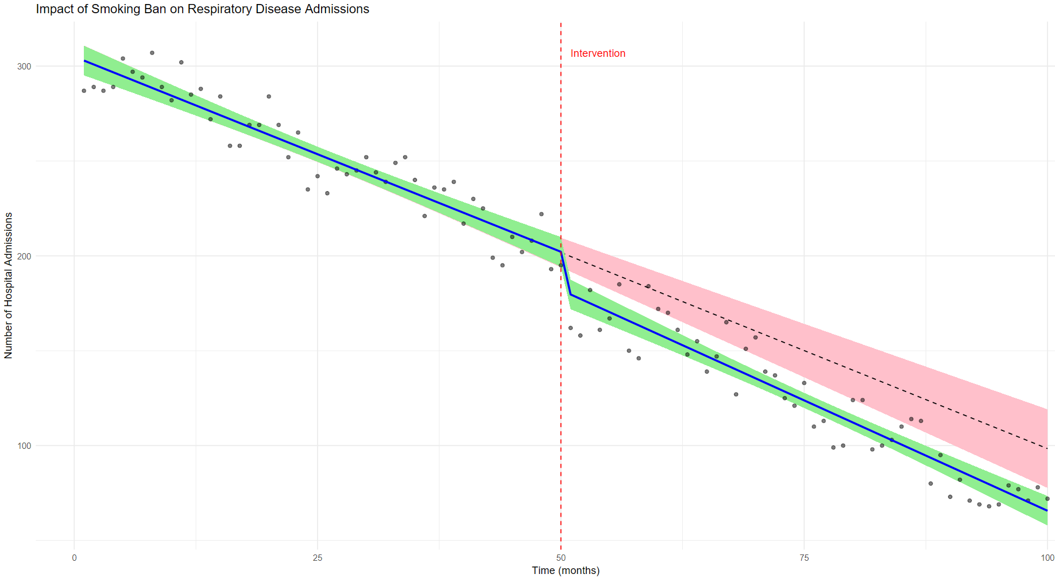
Counter factual – No control, one intervention
Notes:
The solid line with green ribbon is the factual data, the red dashed line with the pink ribbon is the counterfactual. Using the rule of thumb that if the confidence intervals don’t overlap, there’s something significant happening, we can conclude that the interruption preceded a significant step change in admissions. That the lines also diverge suggests that there could be a significant trend change.

Slide 15
Calculate differences
Can now calculate relative differences at different time points.
Notes:
The last remaining thing we need to do is to calculate those relative differences. This is easy because we’ve been adding the modeled values to the df as variables. To get a list of the relative differences at different timepoints, we really only have to do subtract the factual from the counterfactual.
Here we can see that pre-intervention, the difference between factual and counterfactual is essentially zero, which is what we expect. At month 51 we see that the difference is 20 admissions, almost the same as the step change we saw in the coefficients for model previously. At month 100 the factual data are 33 admissions lower than the counterfactual, which is the combined effect of the intervention step change and the intervention trend change.

Slide 16
References
Roberts, Chrissy H. A pragmatic Introduction to Interrupted Time Series. 2023-02-23​​. https://rpubs.com/chrissyhroberts/1006858
International Journal of Epidemiology, 2017, 348–355
Interrupted time series regression for the evaluation of public health interventions:
a tutorial
doi: 10.1093/ije/dyw098
Turner et al. BMC Med Res Methodol (2021) 21:134
Comparison of six statistical methods for interrupted time series studies: empirical evaluation of 190 published series
https://doi.org/10.1186/s12874-021-01306-w

